Slide 1
KYTC District 6 “Great Eight” Incident Management Task Force
April 7, 2015

Slide 2
Introductions

Slide 3
Approval of Minutes
1/7/15 Meeting

Slide 4
Incident Review
I-71 Median Cable Rail Update

Slide 5
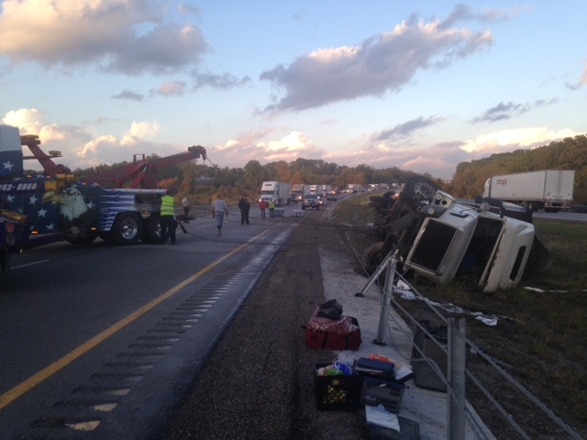

Slide 6
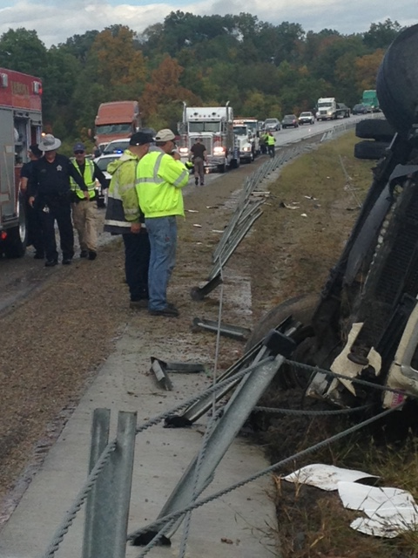

Slide 7
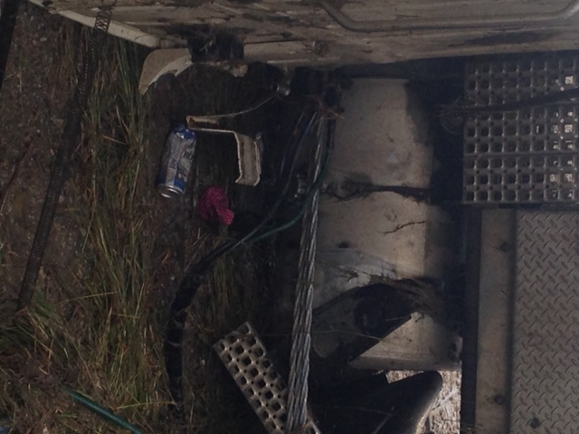

Slide 8
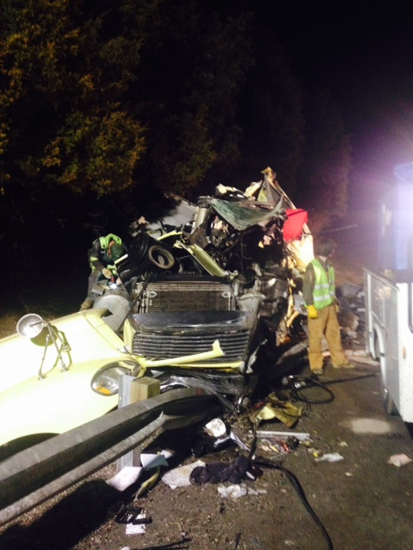

Slide 9
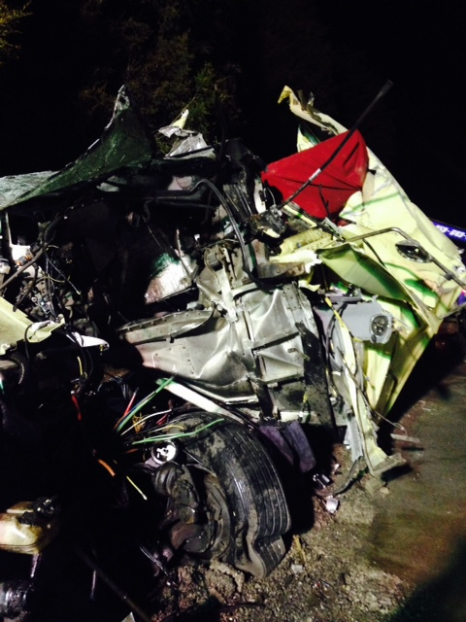

Slide 10
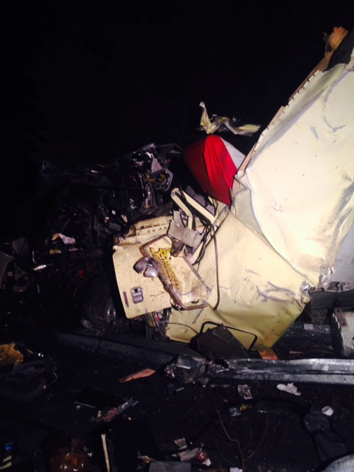

Slide 11
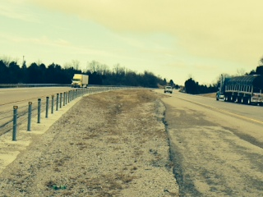

Slide 12
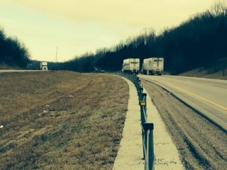

Slide 13
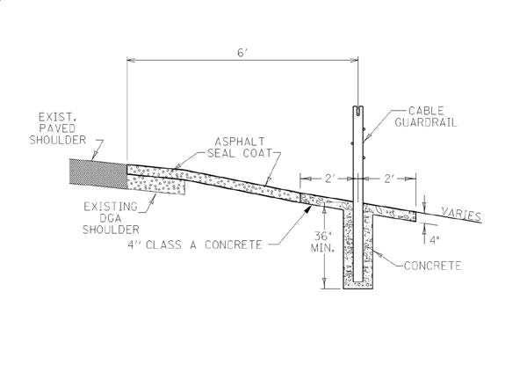

Slide 14
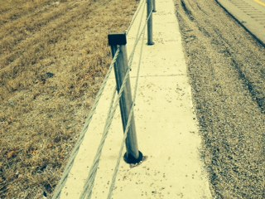

Slide 15
Incident Review
KY 9 (AA Highway) Fatality at Gloria Terrell Drive
Campbell County

Slide 16
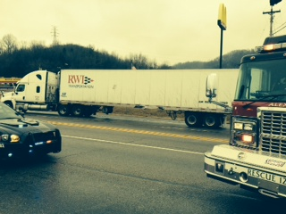

Slide 17
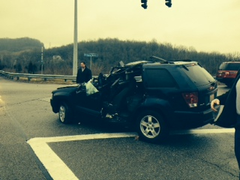

Slide 18
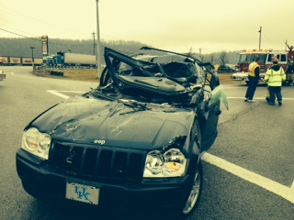

Slide 19
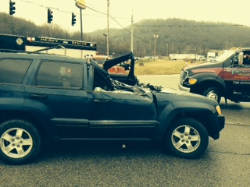

Slide 20
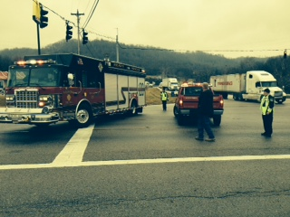

Slide 21
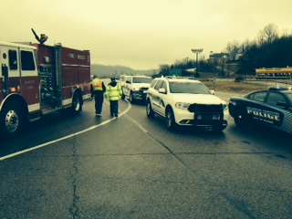

Slide 22
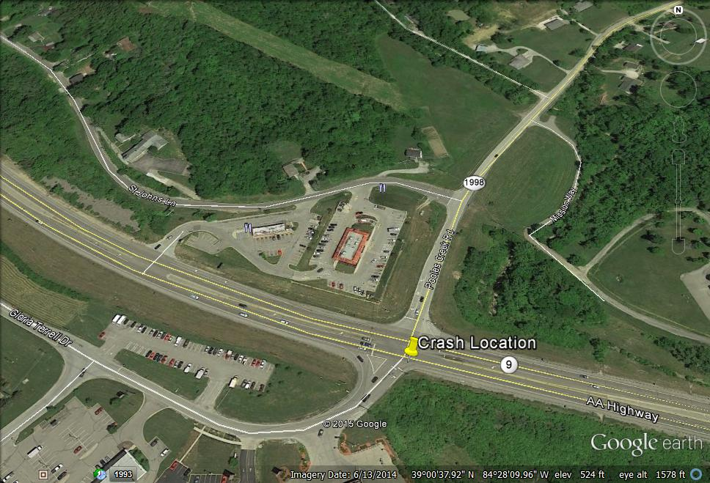

Slide 23
Incident Review
I-71 MP 73 Fatal Crossover Crash 1/29/15
Boone County

Slide 24
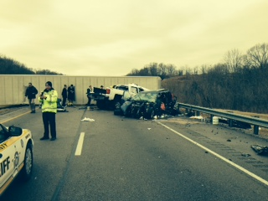

Slide 25
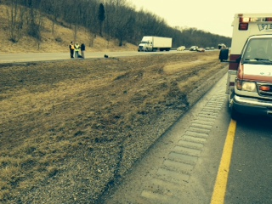

Slide 26
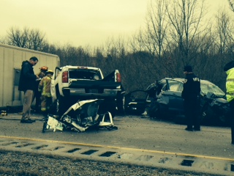

Slide 27
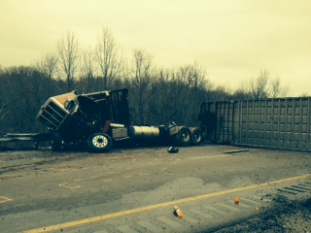

Slide 28
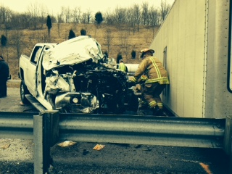

Slide 29
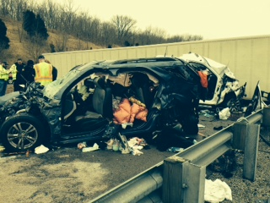

Slide 30
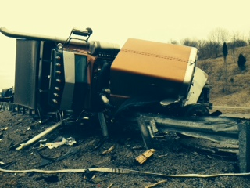

Slide 31
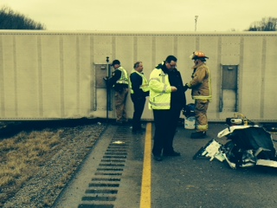

Slide 32
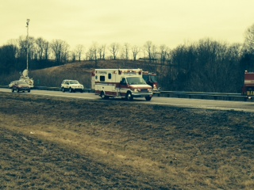

Slide 33
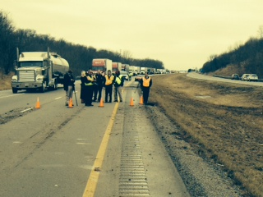

Slide 34
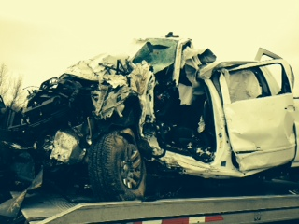

Slide 35
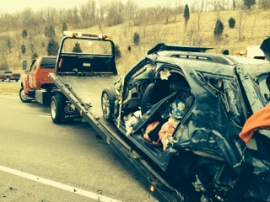

Slide 36
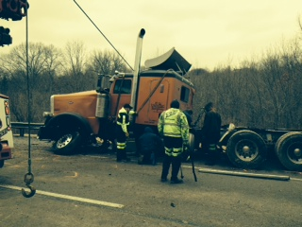

Slide 37
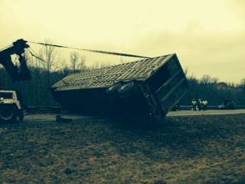

Slide 38
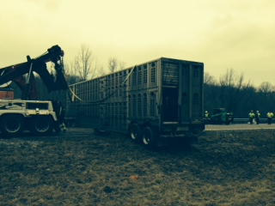

Slide 39
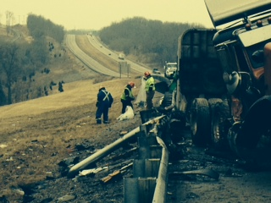

Slide 40
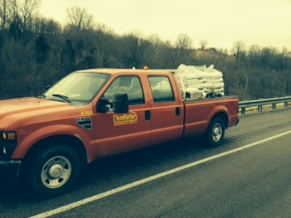

Slide 41
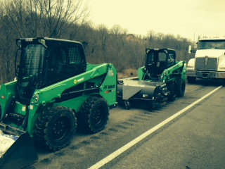

Slide 42
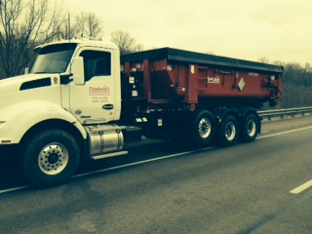

Slide 43
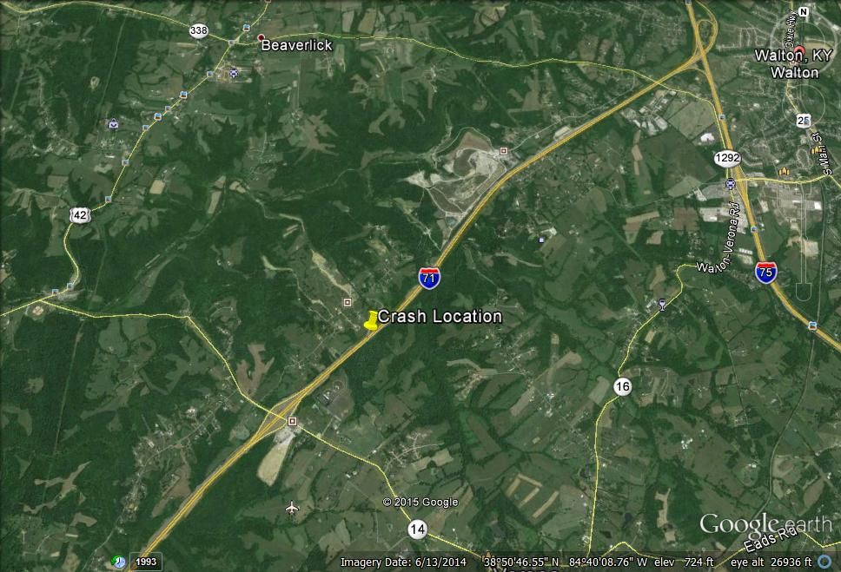

Slide 44
Incident Review
US 27 Head on Collision Fatality 1/29/15
Pendleton County

Slide 45
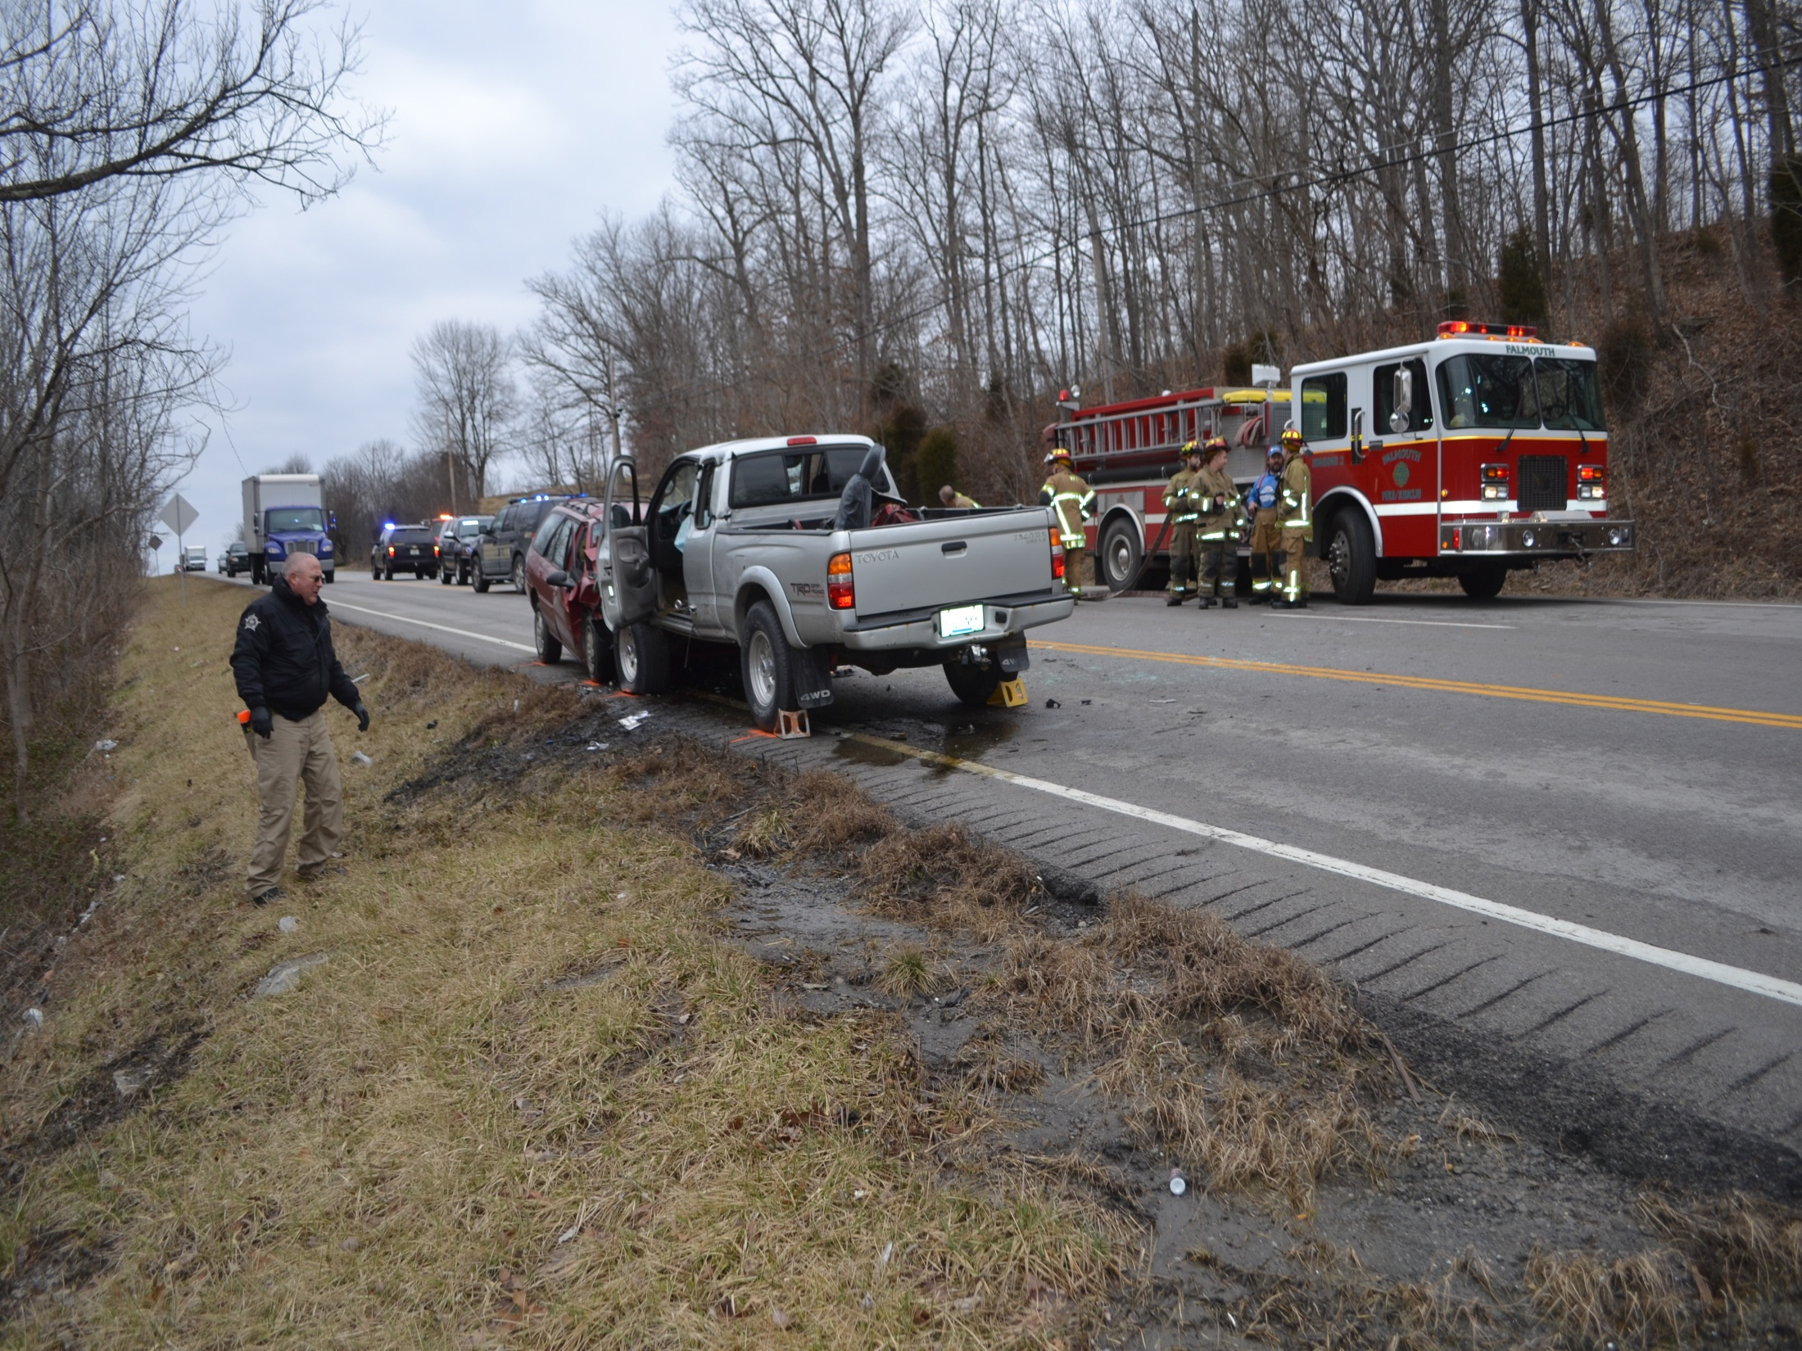

Slide 46
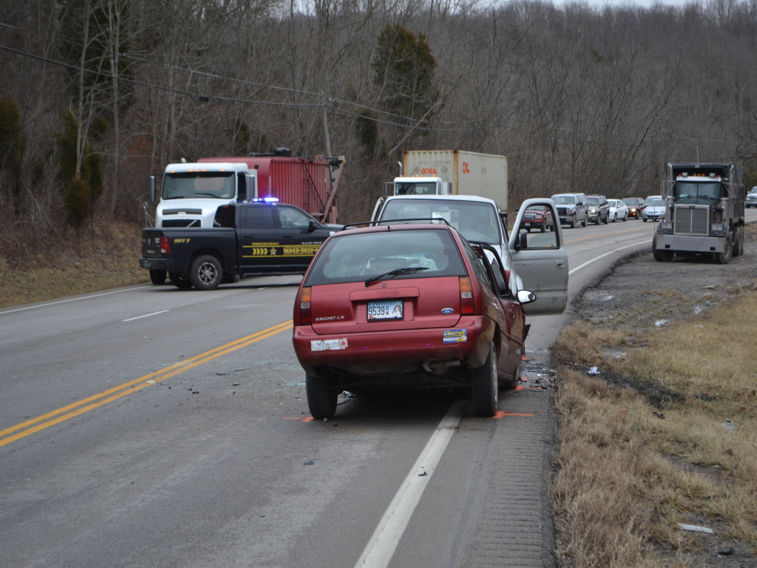

Slide 47
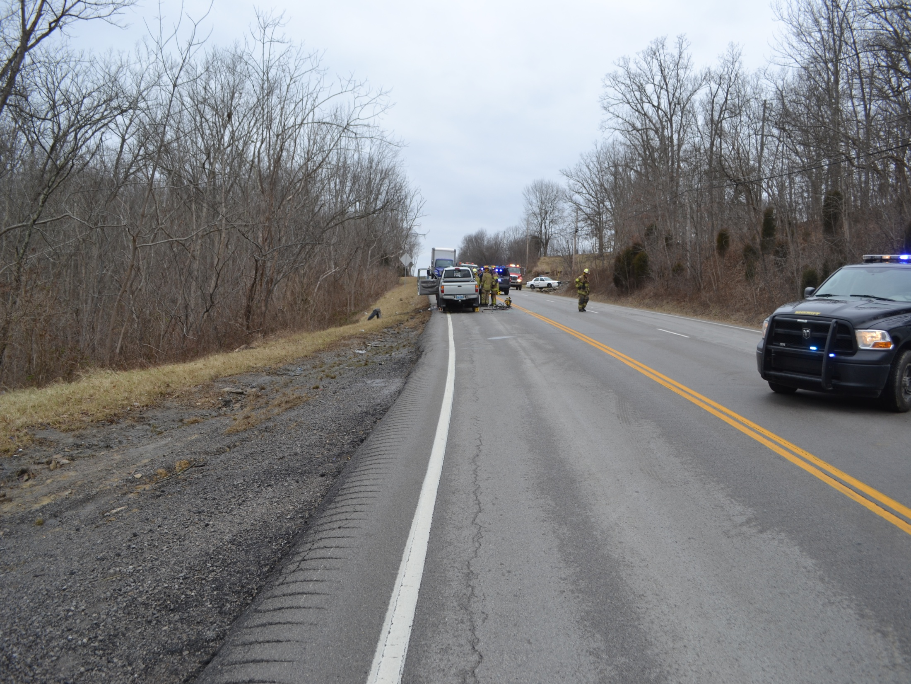

Slide 48
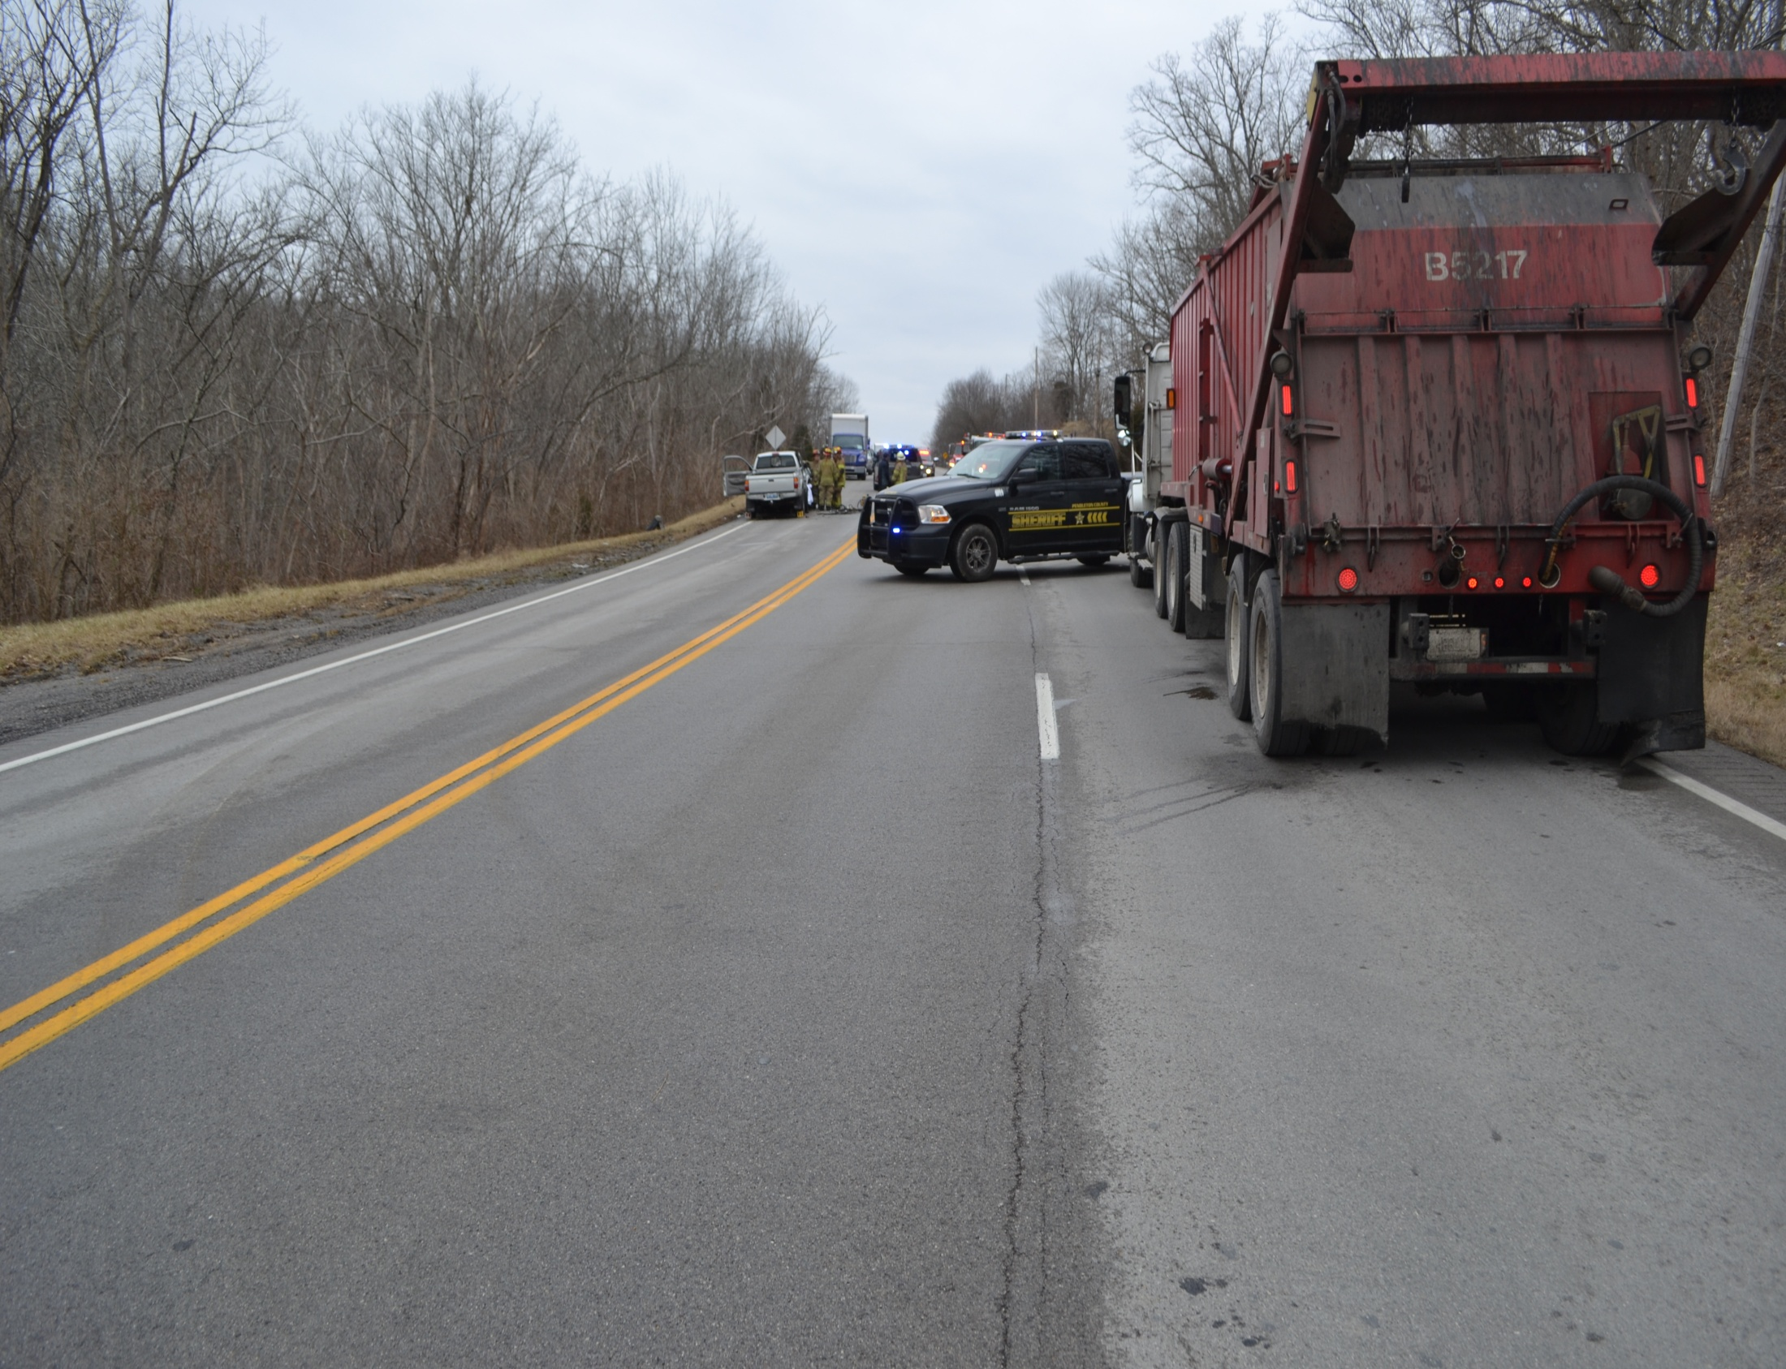

Slide 49
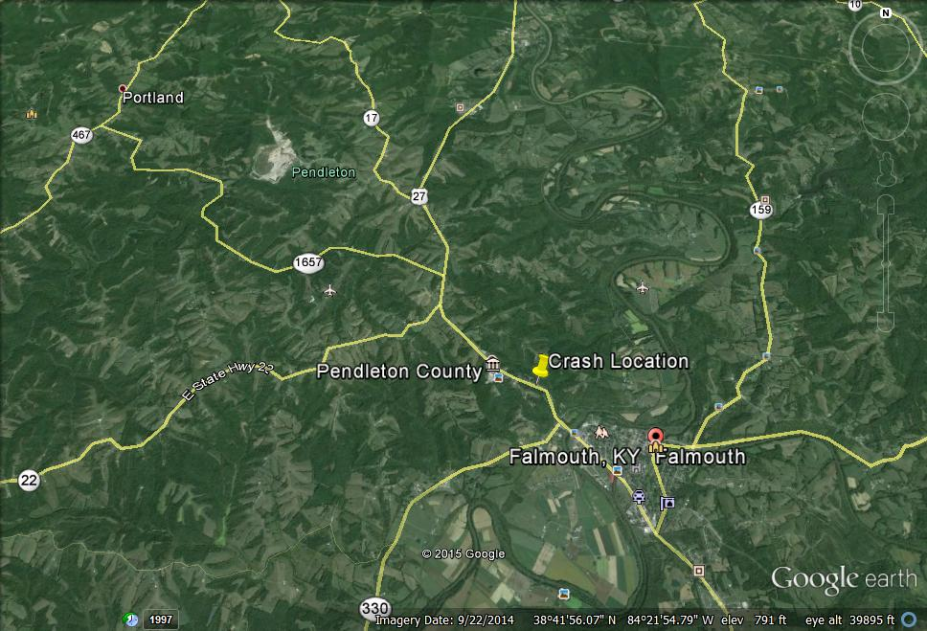

Slide 50
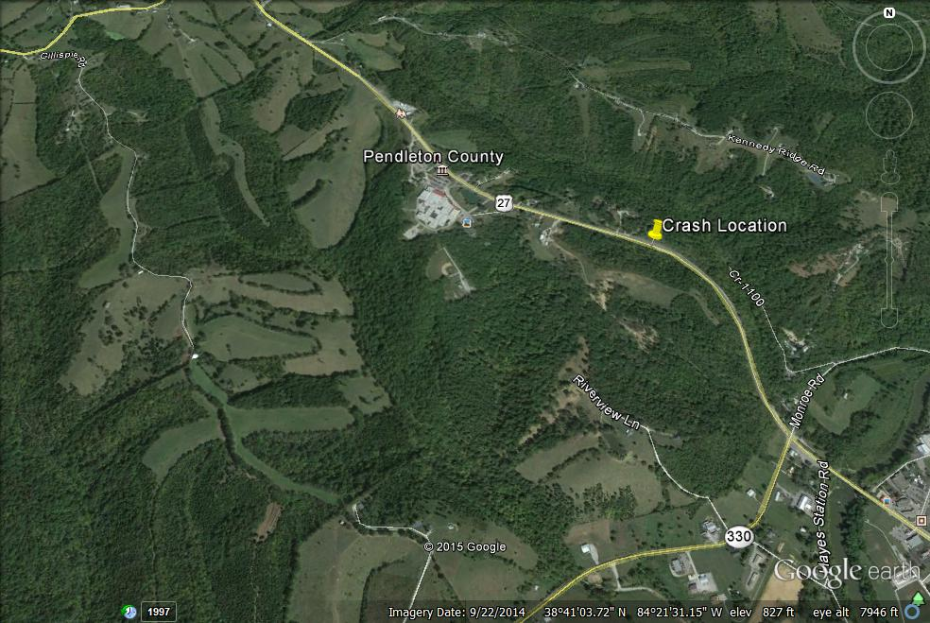

Slide 51
Incident Review
KY 982 Tractor Trailer Rollover 1/31/15
Harrison County

Slide 52
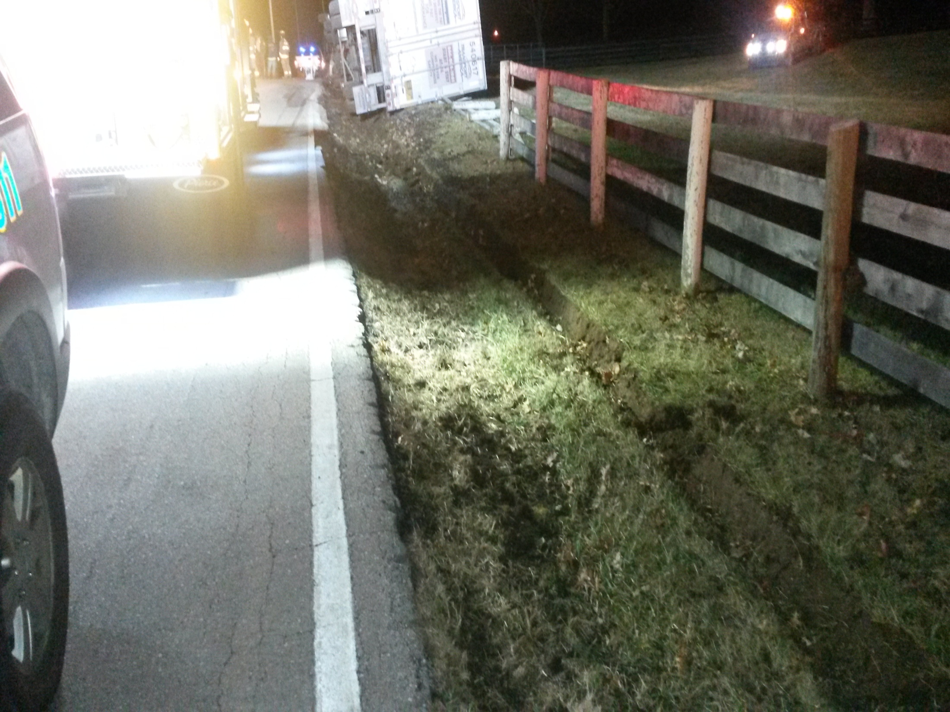

Slide 53
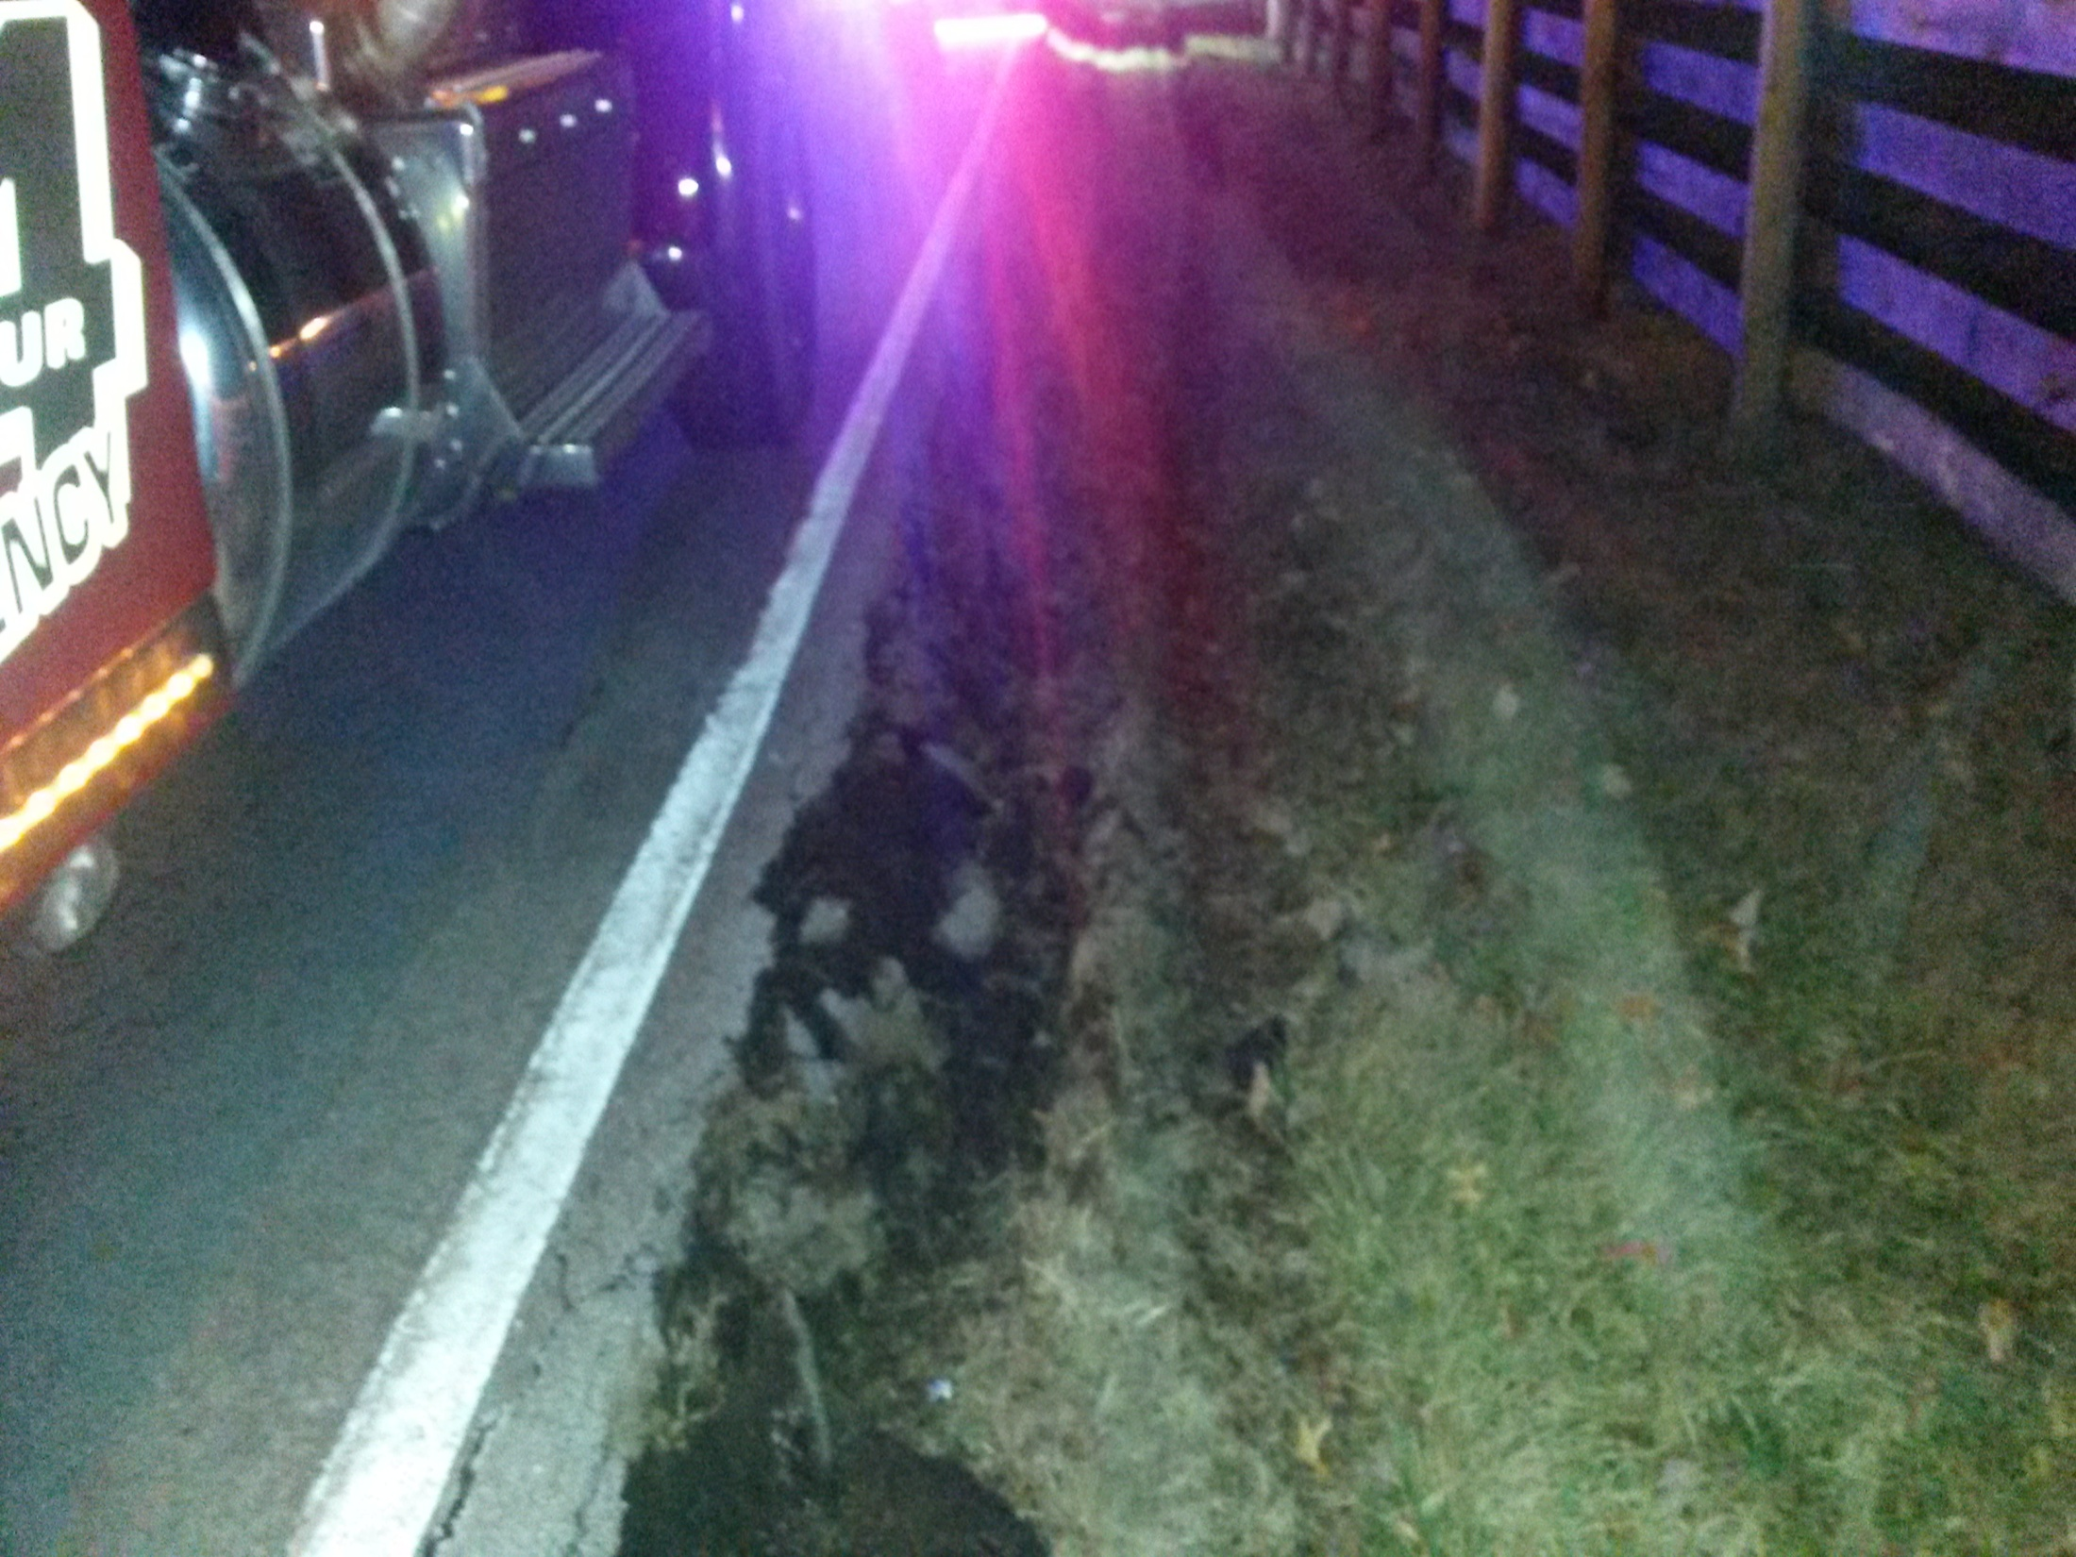

Slide 54
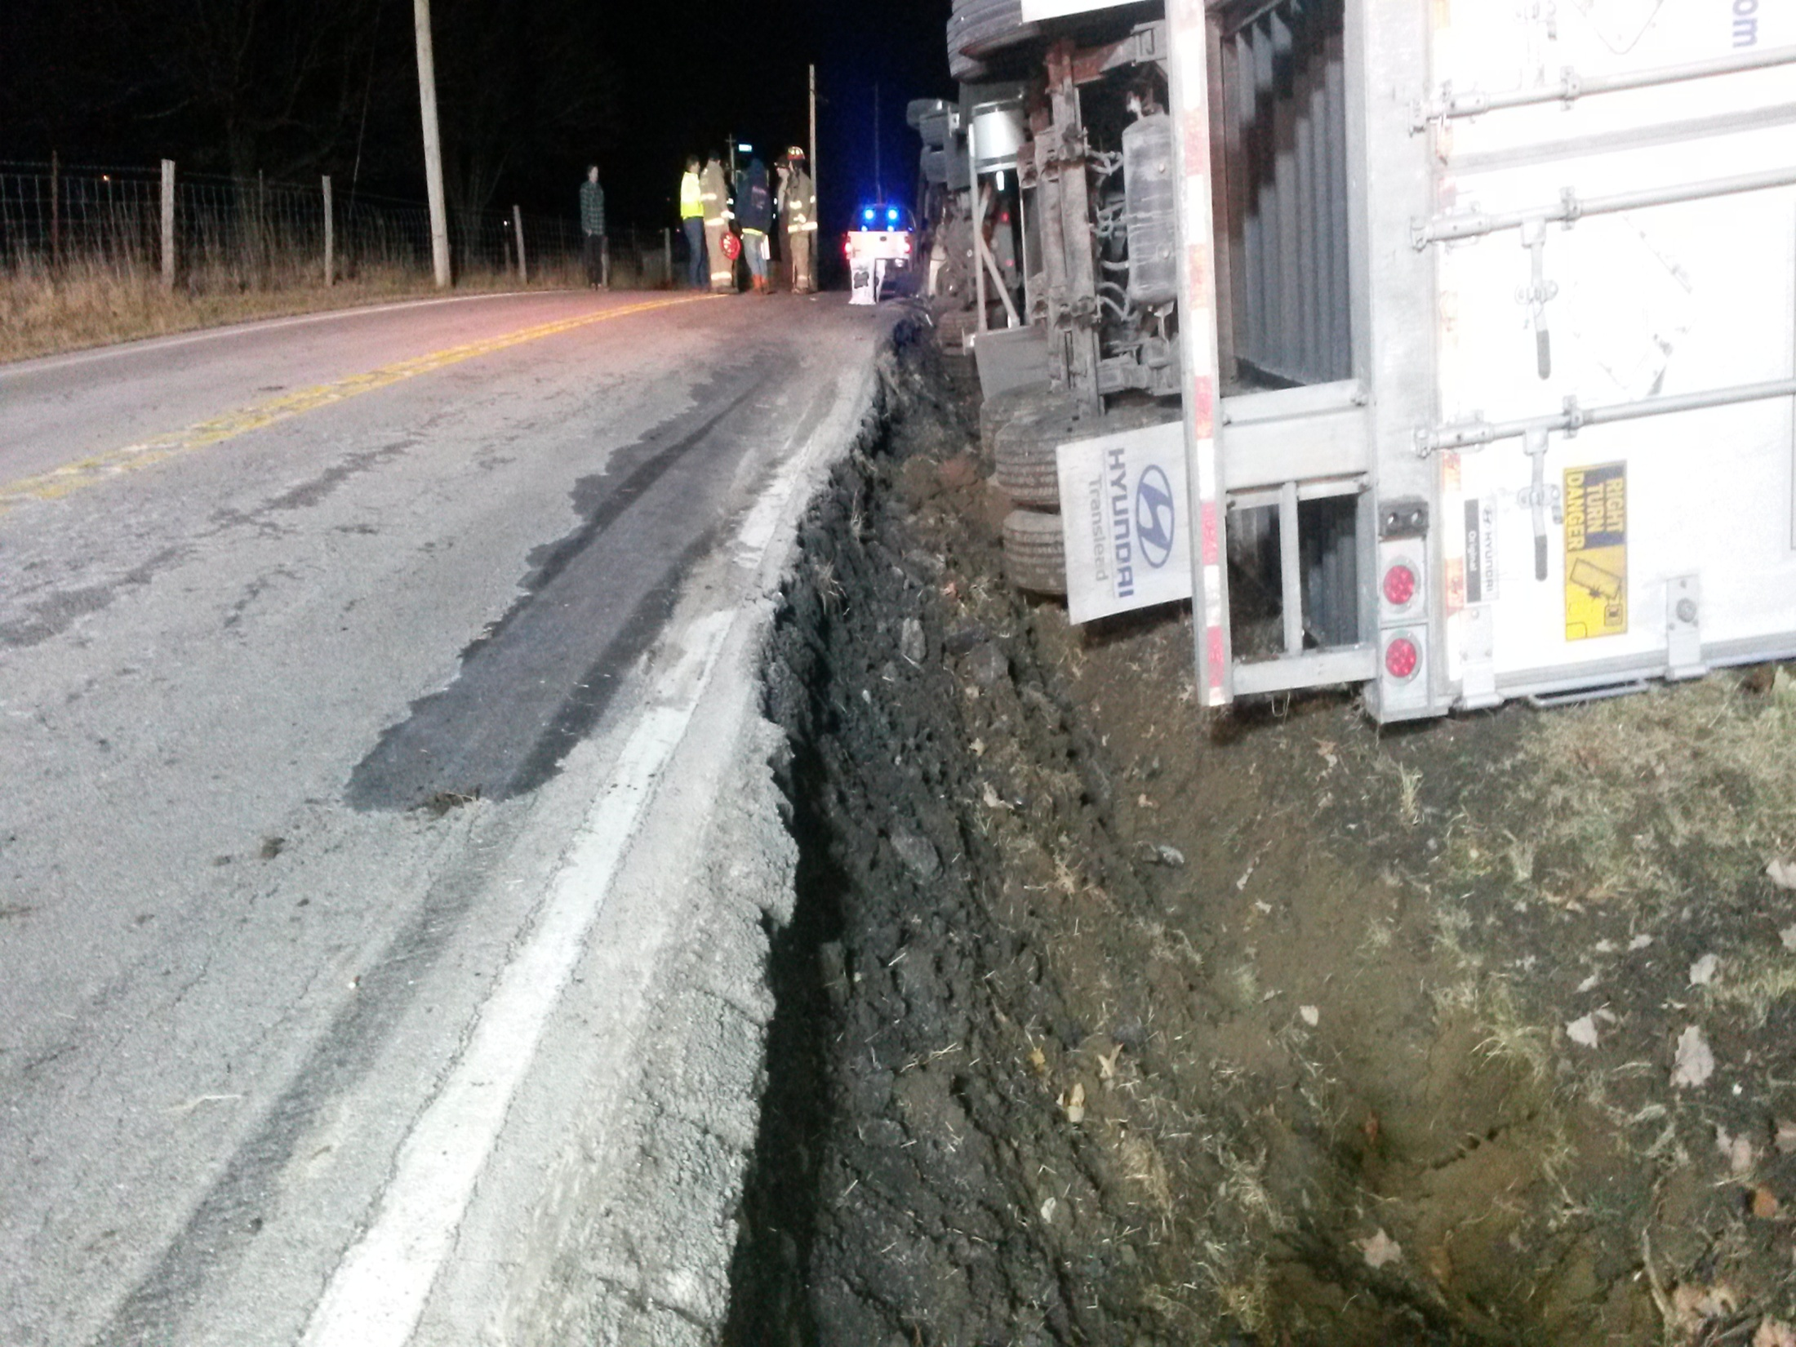

Slide 55
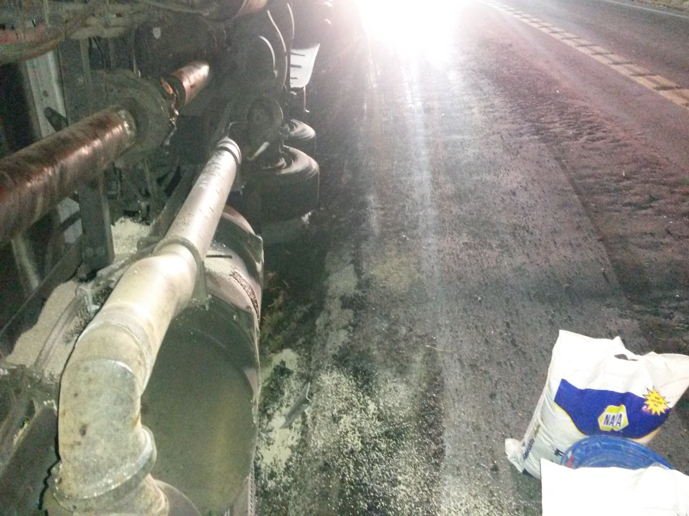

Slide 56
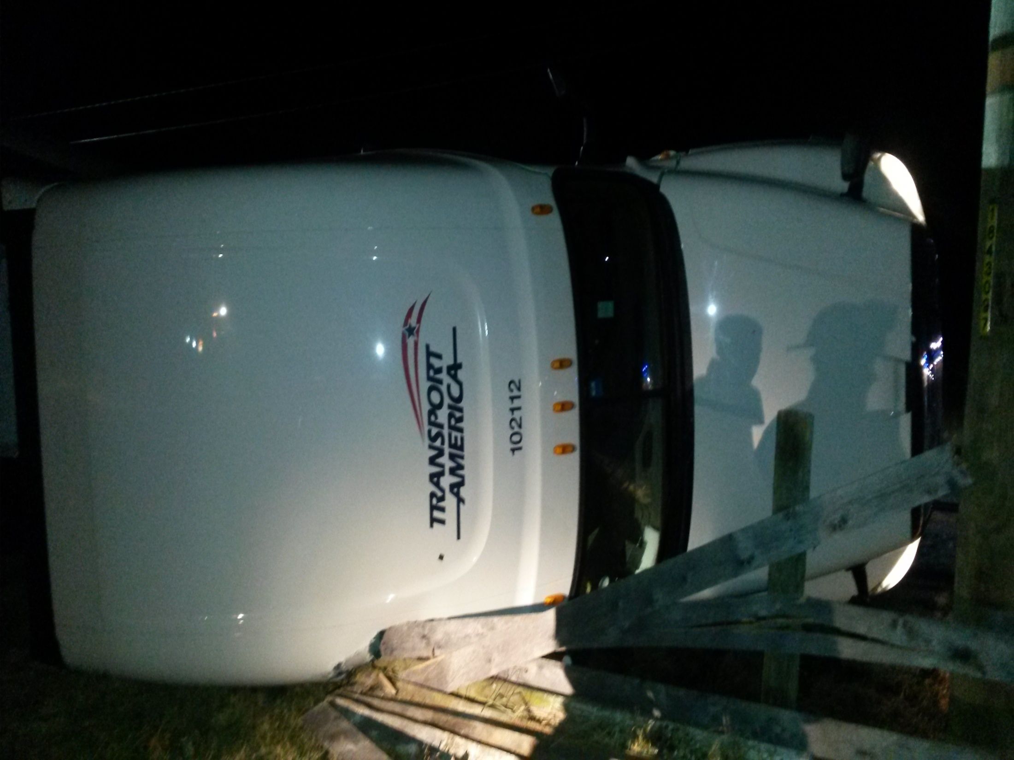

Slide 57
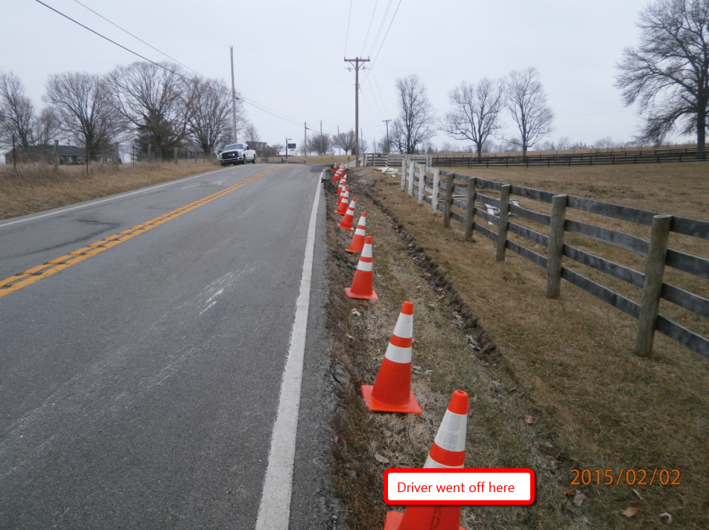

Slide 58
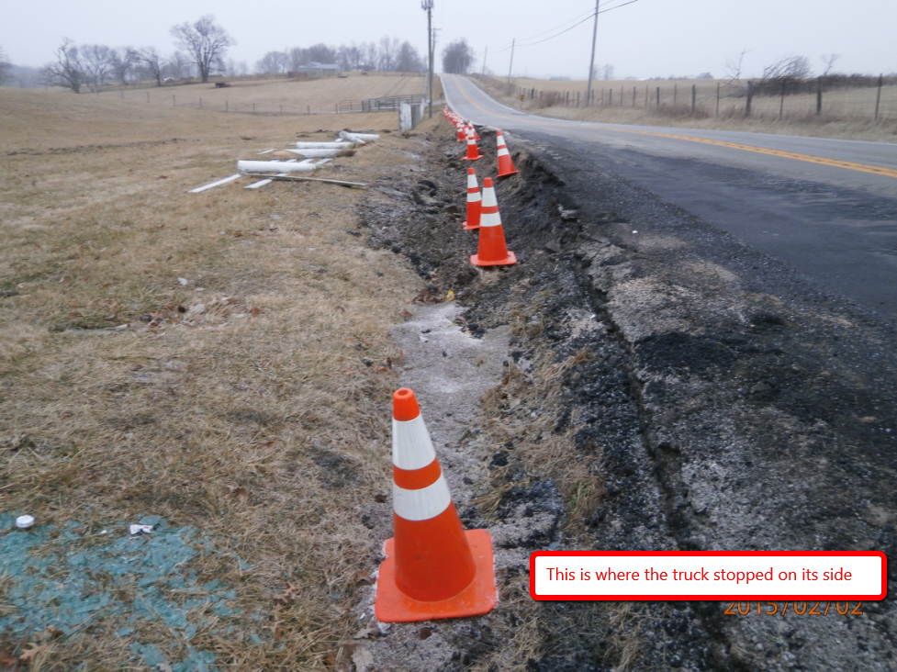

Slide 60
Incident Review
KY 8 Fatality 1/31/15
Bracken County

Slide 63
Crash Statistics
Quarterly Crash Statistics
KSP CRASH Database
Valerie Januski
District 6 Safety Officer

Slide 64
Southeast Counties

Slide 70
Southwest Counties

Slide 76
Yearly Crash Comparison by Route Type
Robertson County
Owen County

Slide 79
Construction Update

Slide 80
Incident Management Training
Megan Perrin
Kentucky Transportation Center
(859) 257-7405 megan.perrin@uky.edu

Slide 81
Other Business

Slide 82
Adjourn
Next Meeting
Tuesday July 7, 2015
1:00 PM

